Slide 1


Implementing an Open-access, Data-Science Programming Environment for Everyone
Austin Cory Bart, Javier Tibau, Eli Tilevich, Clifford A. Shaffer, Dennis Kafura
COMPSAC 2016 – CELT
June 13, 2016
This material is based upon work supported by the National Science Foundation Graduate Research Fellowship, Grant No. DGE 0822220

Slide 2


Who am I?
Austin Cory Bart
PhD in Computer Science
Certification in Learning Sciences
(Software + Instructional) Design
Graduating Spring 2017!

Slide 3
Overview
Motivation
Demo
Features
Evaluations
Future Work

Slide 4
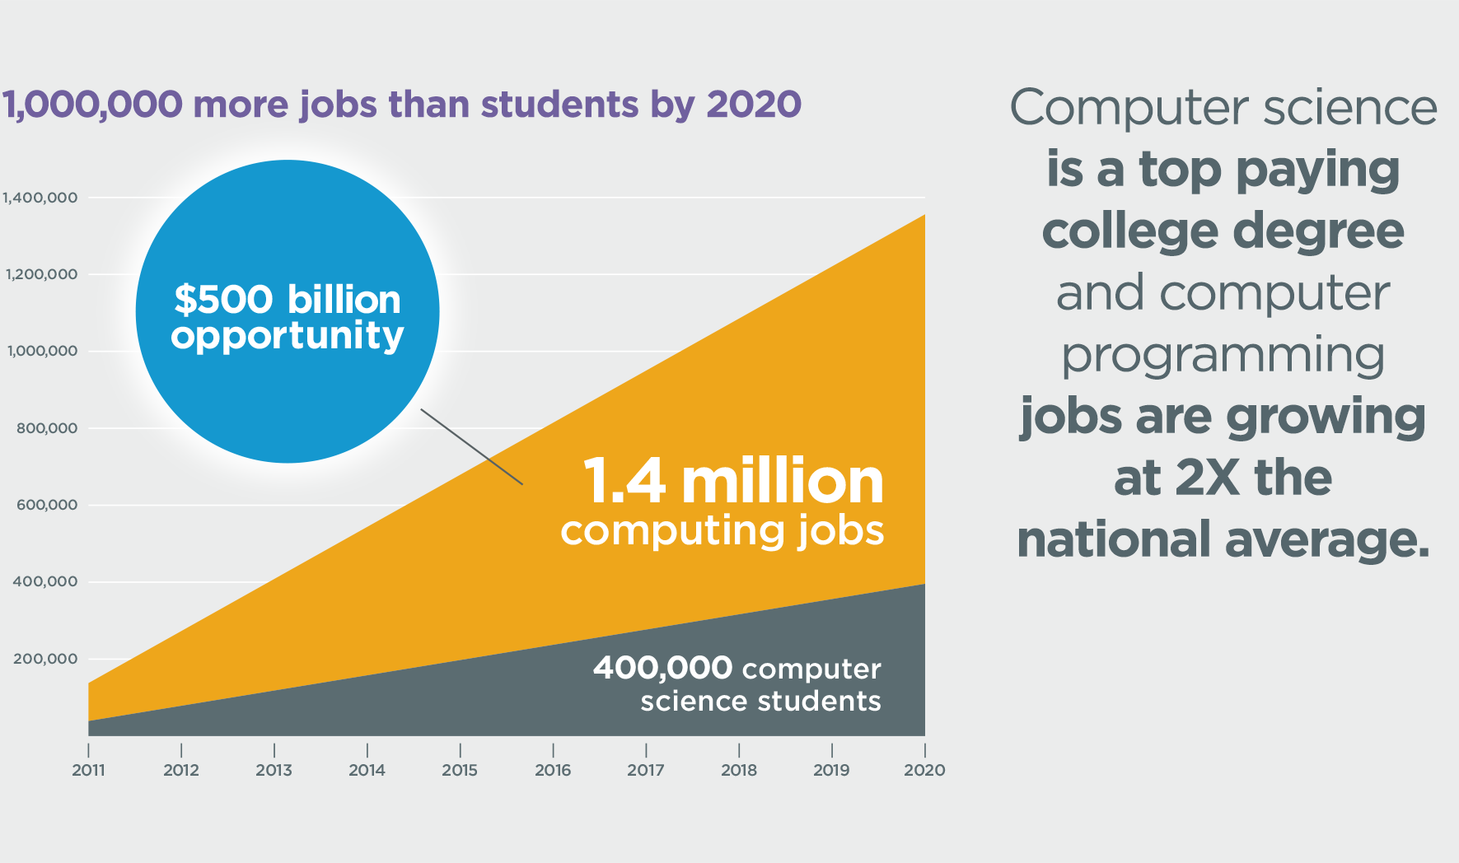
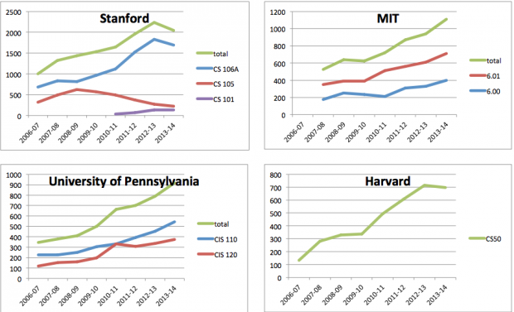
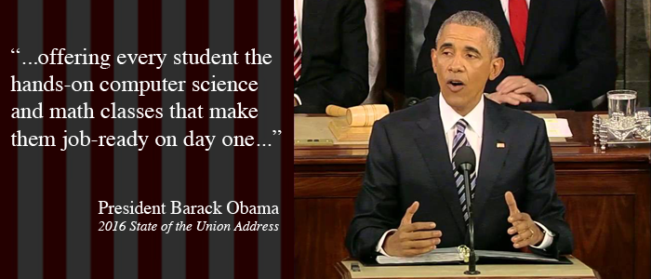
Computing For Everyone

Slide 5

The Local Interest
“To this end, Virginia Tech will comprehensively evaluate and modify the current Curriculum for Liberal Education to … incorporate computational thinking and informatics/digital fluency as basic skills for all students, thereby enabling our students to be engaged citizens and life-long learners.”

Slide 6
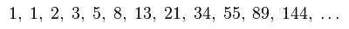
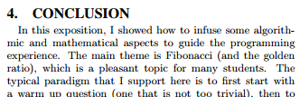
Contexts: Math and Business
Pure Math (e.g., Fibonacci)
Saad Mneimneh. 2015. Fibonacci in The Curriculum: Not Just a Bad Recurrence. In Proceedings of the 46th ACM Technical Symposium on Computer Science Education (SIGCSE '15). ACM, New York, NY, USA, 253-258.

Slide 7
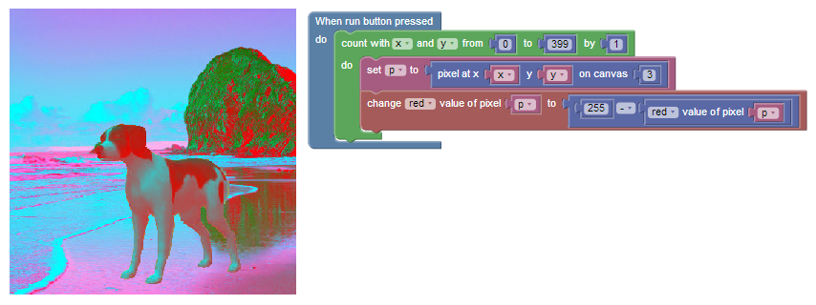

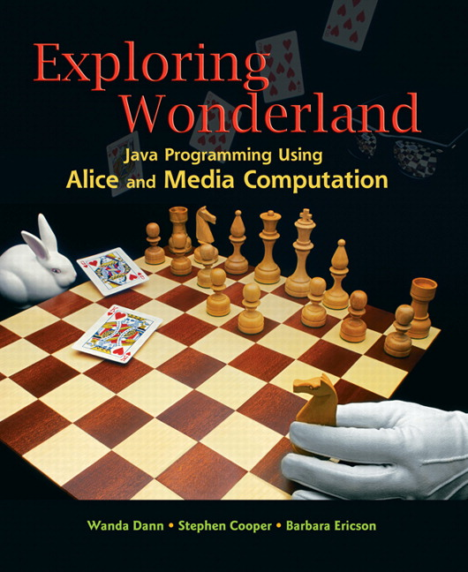
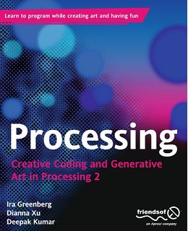
Fun to the rescue!
… But authentic?
*Mark Guzdial and Allison Elliott Tew. 2006. Imagineering inauthentic legitimate peripheral participation: an instructional design approach for motivating computing education. In Proceedings of the second international workshop on Computing education research (ICER '06). ACM, New York, NY, USA, 51-58. DOI=10.1145/1151588.1151597 http://doi.acm.org/10.1145/1151588.1151597

Slide 8


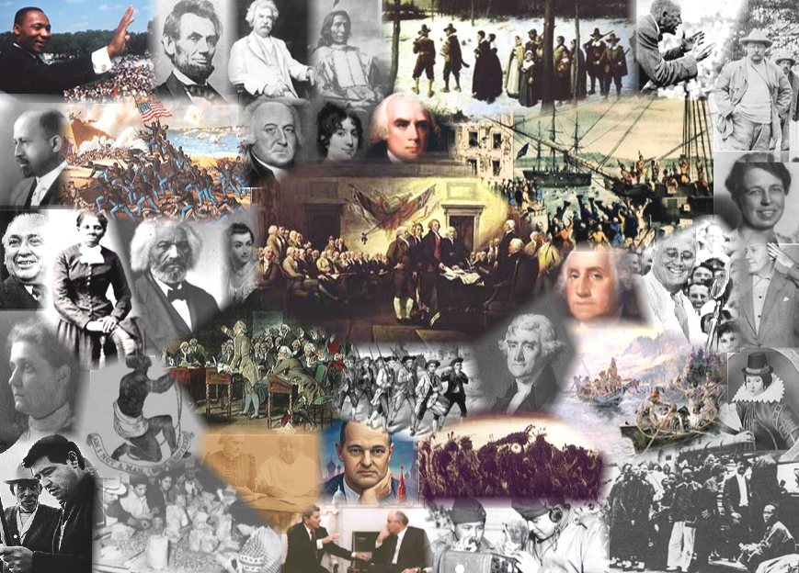
Diverse Majors
… with Rich Knowledge
English
Biological Sciences
Animal Sciences
Education
Theater Arts
History
Building Construction

Slide 9
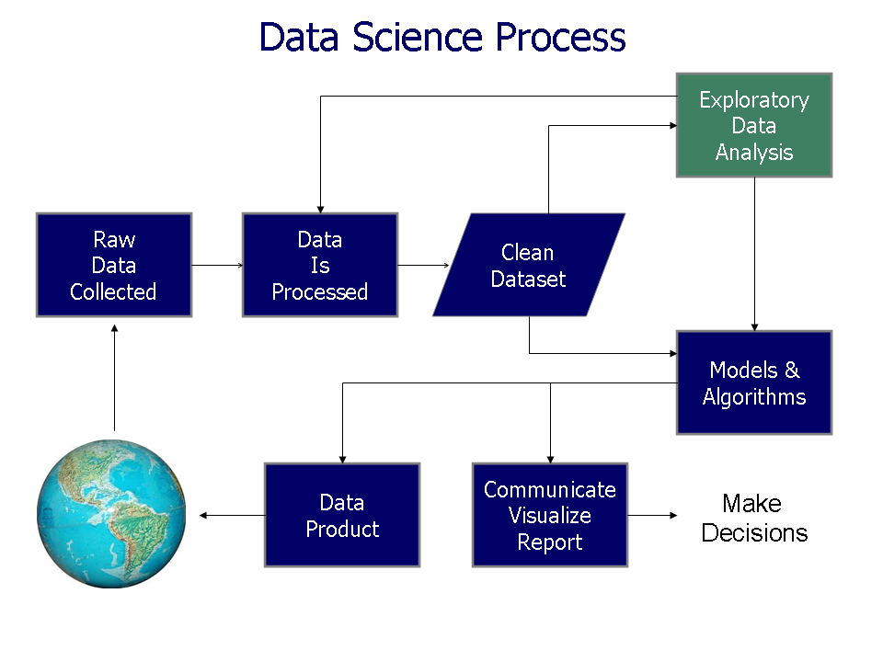
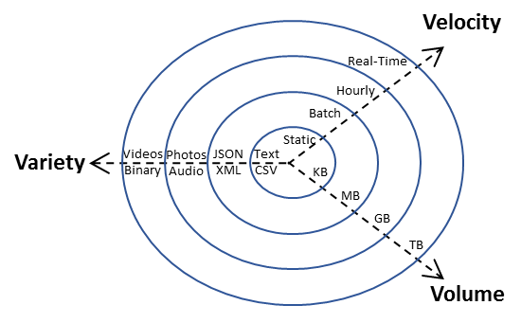
Big Idea: Real-World Data

Slide 10
Computational Thinking via Data Science
Computational modelling with NetLogo
Short practice problems in Python
A month-long Python project in real IDE
Kafura, Dennis, Austin Cory Bart, and Bushra Chowdhury. "Design and Preliminary Results From a Computational Thinking Course." Proceedings of the 2015 ACM Conference on Innovation and Technology in Computer Science Education. ACM, 2015.

Slide 11
Design Goals
Diverse learners
And many of them
With low self-efficacy

Slide 12
Design Goals
Diverse learners
And many of them
With low self-efficacy
Give authentic problems
Minimize human effort
Reduce barriers
Fade scaffolds

Slide 13
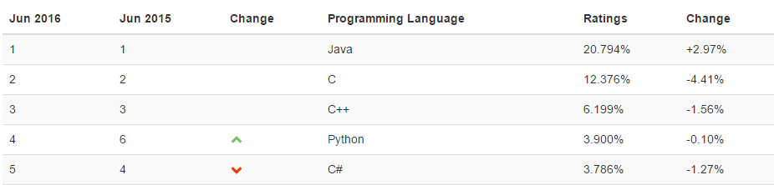
Python
Popular intro language
Popular data science language
Many great libraries
TIOBE Index

Slide 14
Existing Solutions?
Block-based Environments
Python in the Browser
Blockly
Scratch
Snap
Greenfoot
CodeSkulptor
Pythy
Online Python Tutor
Not Python
No blocks

Slide 15

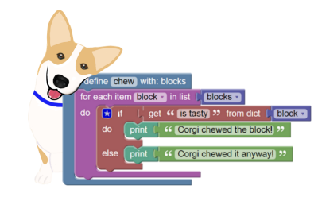

BlockPy

Slide 16
BlockPy
www.blockpy.com
github.com/RealTimeWeb/blockpy/

Slide 17
BlockPy “Secret Sauce”
Dual text/block
Data Science
Auto Feedback

Slide 18
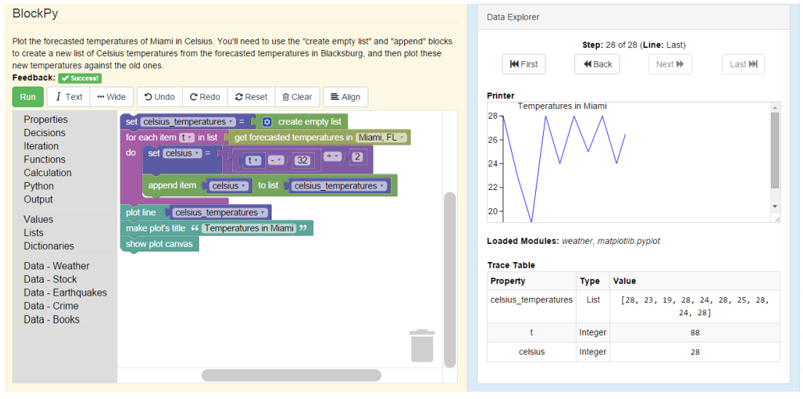
Architecture
Client (Student Browser)
BlockPy Server
Assignment/Submission
Persistence
Blockly (Visual Block Interface)
Learning Management System
Skulpt (Python Execution Engine)
Grade Tracking

Slide 19
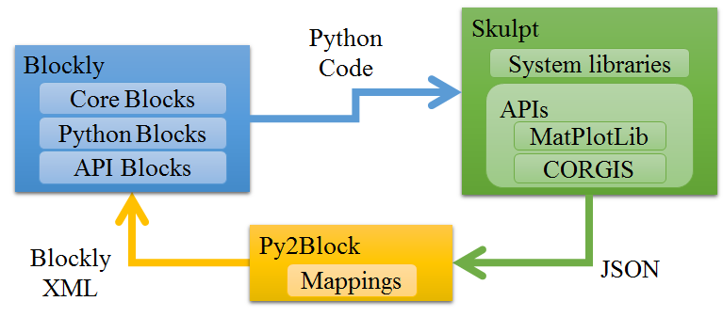
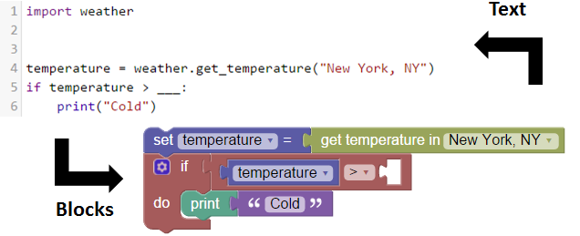
Mutual Language Translation
Code Execution

Slide 20

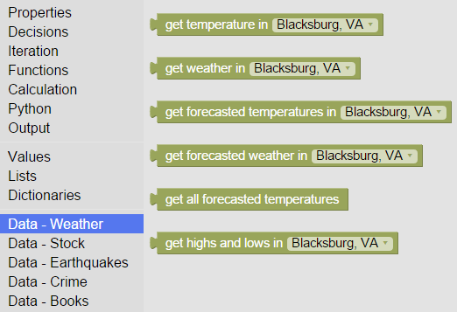






Data Blocks
Collections Of
Real-time
Giant
Interesting
Situated
Datasets
Tilevich, Eli, Clifford A. Shaffer, and Austin Cory Bart. "Creating stimulating, relevant, and manageable introductory computer science projects that utilize real-time, large, web-based datasets." Proceedings of the 46th ACM Technical Symposium on Computer Science Education. ACM, 2015.

Slide 22
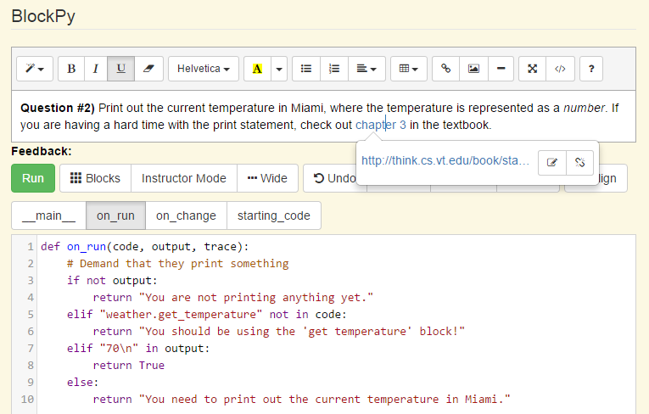
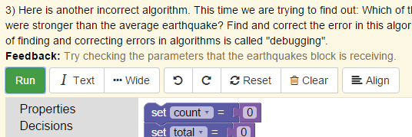
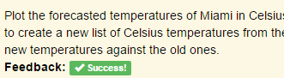
Guided Practice Problems

Slide 23
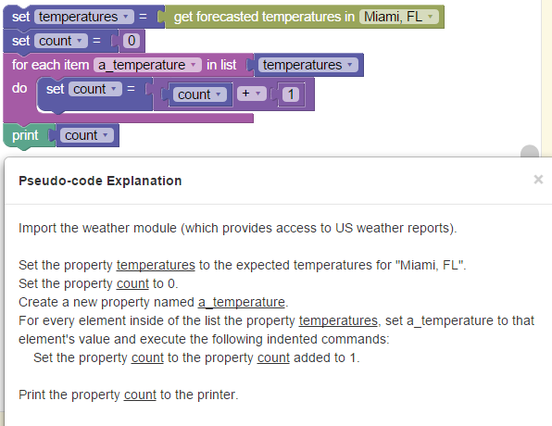
Pseudo-Code

Slide 24
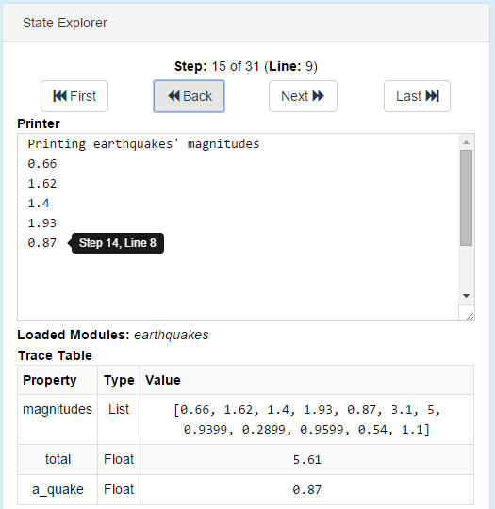
State Explorer
Rewind variables AND console
Trace step and line

Slide 25
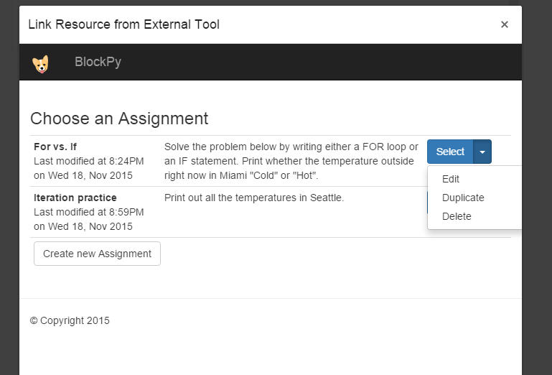
LTI Interface

Slide 26
Evaluation
Spring 2015
Spring 2016
35 students
4 days
57% female
Version 1
50 students
5 days
50% female
Version 2
Two different post-surveys
Transition into Spyder

Slide 27
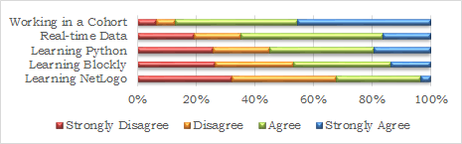
Spring 2015 – Usefulness of Resource
Which learning resource is most helpful to students’ learning?

Slide 28
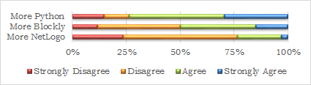
Spring 2015 - Perceptions
Do students want more time with NetLogo, BlockPy (Blockly), or Spyder (Python)?

Slide 29
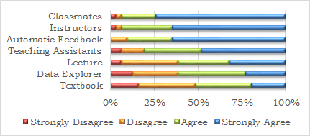
Spring 2015 – Post-Survey
How helpful to students’ learning were these resources?

Slide 30
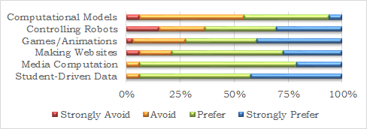
Spring 2015 – Contexts
Which context seems most preferable to students?

Slide 31
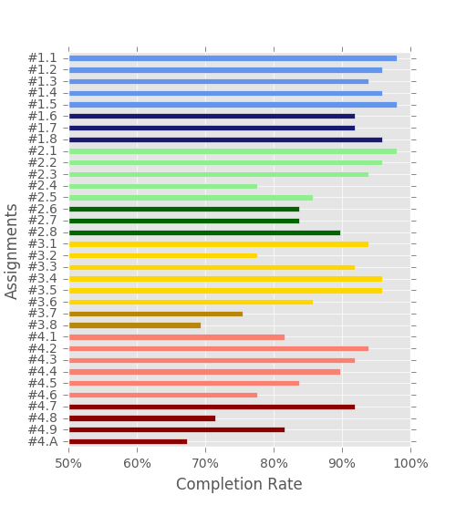
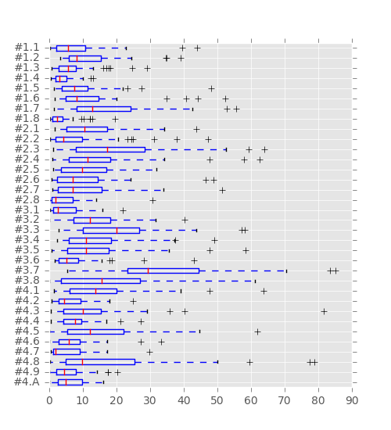
Spring 2016 – Curriculum progress
Most students completed most problems
Most problems took about 15 minutes
Notes:
Most problems were completed by more than 75% of the students; further analysis of the log data suggests that most students were able to complete most problems.
The average student was able to complete most problems in 15 minutes, which was considered reasonable by the instructors.
Although the aggregate set of problems was promising, inadequacies exist within the curriculum.
Some problems seemed to take students much longer than anticipated, such as #3.7, which had students writing code from scratch to identify the index of the minimum value in a list.

Slide 32
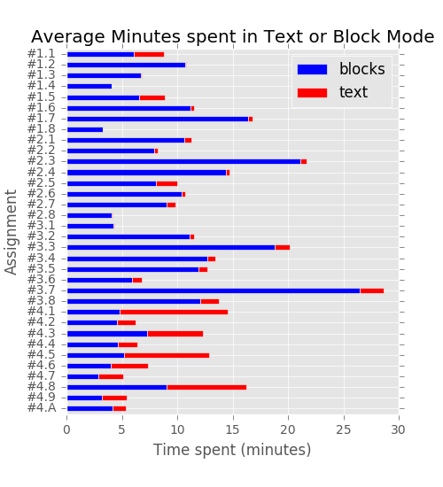
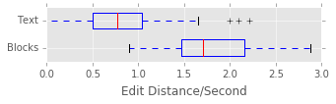
Spring 2016 – Dual block/text
Blocks generate more code/sec
Students did transition to text

Slide 33
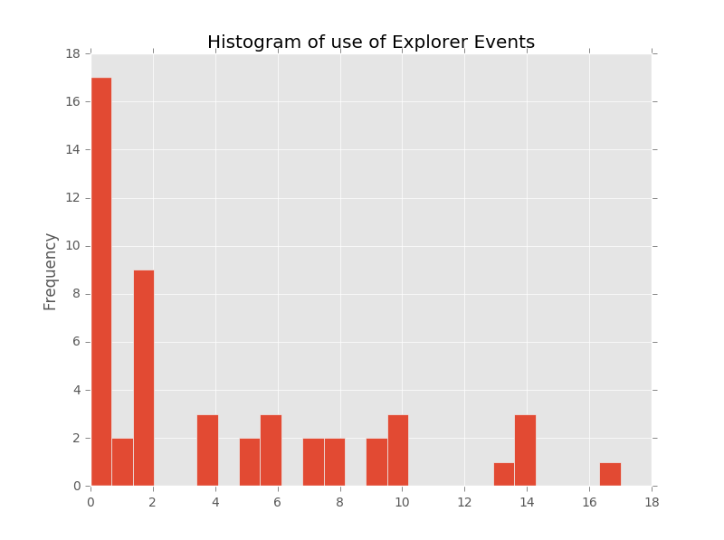
Spring 2016 – Tool events
Students use tools sparingly

Slide 34
Spring 2016 – Qualitative Results
BlockPy => Spyder transition point was good
Error reporting was better in Spyder
2/3 of students singled out blocks as helpful (only 12% singled out auto feedback)
Notes:
The majority (68\%, or 28 students) of students felt that the current location was appropriate, 6 students felt it should be later or always in BlockPy (7\% and 7\% respectively), and 7 students felt it should be when iteration was taught (17\%).

Slide 35
Semantic Errors
Semantic errors are slipping through
import stocks
stocks = stocks.get_past("FB")
new = []
if new:
new = new + stocks
for stocks in stocks:
print(stocks)
Dead codepath
Iteration list is the same as the iteration variable
Incorrect appending

Slide 36
Looking forward
How do we perfect the blocks?
How can we give better feedback?
How can we let students do better data science?

Slide 37

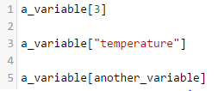

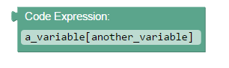
Mutual Language Translation
"Impossible in a dynamic language!"

Slide 38
Yes, and our programs are different
<10-15 lines of code
Limited control flow: for-each, if, ...
Only built-in types (int, float, str, dict, list)
Forbid re-typing
We can say roughly what it should look like

Slide 39
Static type inference?
"Giving people a dynamically-typed language does not mean that they write dynamically-typed programs."
Aycock, John. "Aggressive type inference." language 1050 (2009): 18.
Assume any given variable is given a type, and use regular flow-insensitive program analysis.

Slide 40
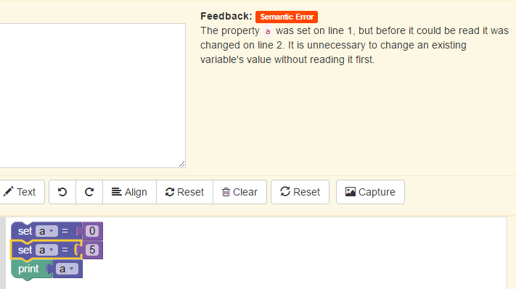
The Next Iteration
Semantic Errors
Better error locating

Slide 41
Conclusions
BlockPy
Dual text/block
Auto feedback
Data Science
For experimental curriculum

Slide 42
Thanks!
Questions?

